Slide 1
NLP News Classification
By: Hanan Salih Shahad Abdulbari Raheed Fadi
Supervised By: Dr. Ali Mohsin

Slide 2
Overview
01
05
03
04
Used Dataset
Introduction
02
Problem Statement
06
Proposed Methodology
07
GUI
Project Objectives
Project Scope
08
Result Tables

Slide 3
Introduction
News plays a vital role in educating, entertaining, and advertising, with its main purpose being to keep individuals updated on events that could affect their lives. It addresses critical topics across politics, business, sports, technology, and health, ensuring people have access to essential information.
News websites usually organize content into categories, though some unclassified news is also present. Moreover, Categorizing news enables users to access their preferred news in real-time, helping them save time.

Slide 4
Problem statement
Unclassified news creates confusion for readers, making it difficult to locate similar content without proper categorization of news articles
Categorizing issue: Searching word for word in each article to separate them into categories is difficult and takes a long time.

Slide 5
Problem objectives
Multiple classification methods can predict news article categories using SVM, neural networks, and random forest
Remove extra words and revert keywords to their original form to improve execution speed by using two feature extraction methods: TF-IDF and BOW.

Slide 6
Project Scope
Dataset: AG News Classification Dataset
Methods: SVM, NN, RF
Framework: Anaconda - spider.
Programming Language & version: Python (3.12.4).
RAM: 16.0 GB.
Processor: Intel i5-12500H.

Slide 7
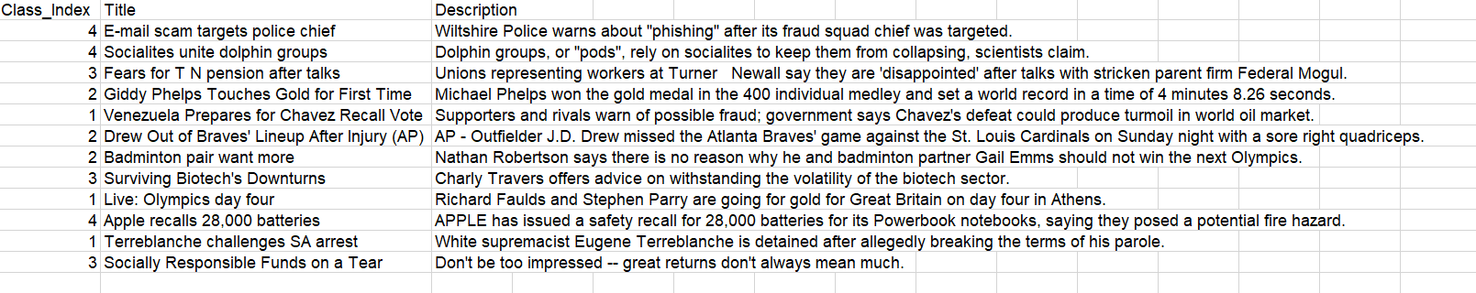
Part of the used dataset
The AG News Classification Dataset is about news articles, it has 3 fields first is the class_index which refer to the class type either World, Sports, Business or Sci/Tech, second is the title that contain the titles of the articles and lastly the documents containing the articles. Our dataset has 120,000 records they're divided into two parts 80% for training consists of 96,000 samples and 20% for testing consists of 24,000 samples, evenly distributes across the four classes.

Slide 8
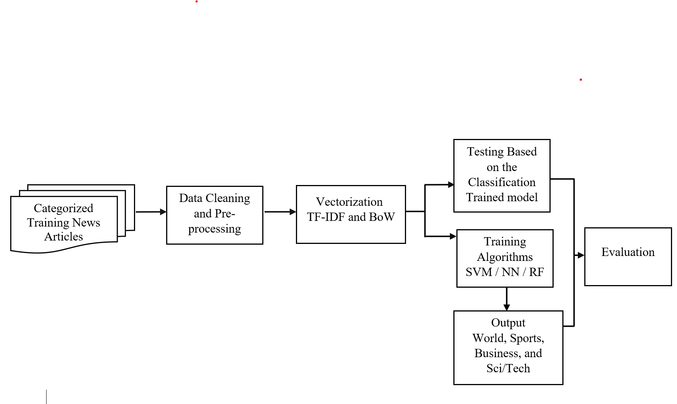
Proposed Methodology

Slide 9
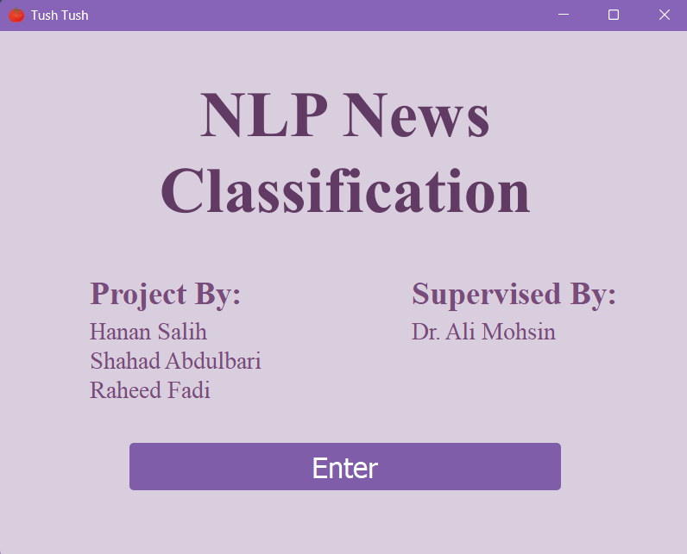
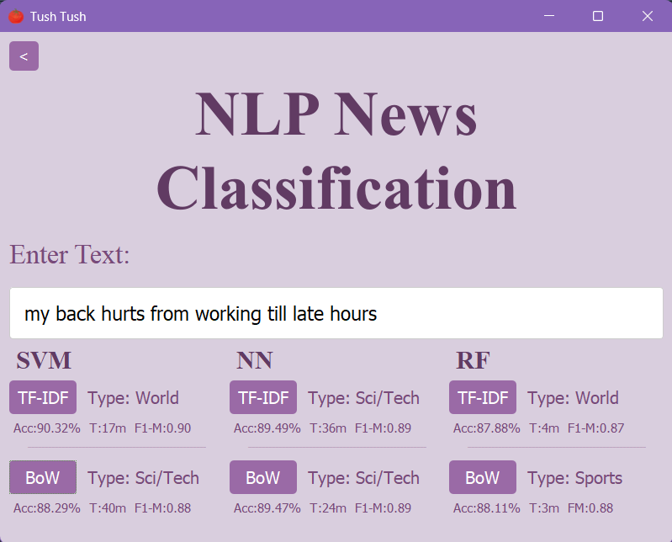
GUI

Slide 10
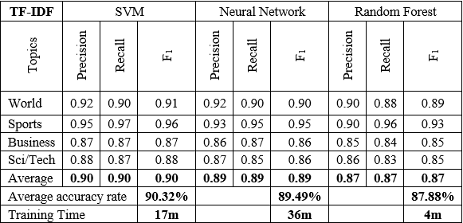
Result table TF-IDF

Slide 11
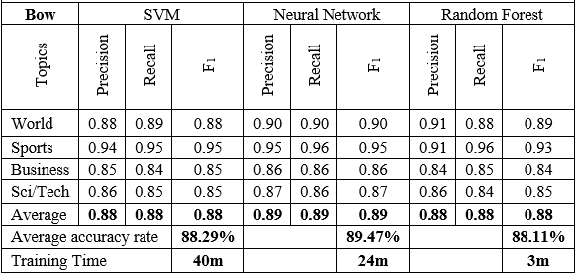
Result table BoW

Slide 12
Thanks.

